Slide 1
Abstract class and methods
Prepared by: dimple bohra

Slide 2
abstraction
It is a process of hiding the implementation details and showing only functionality to the user.
In other words, it shows only essential things to the user and hides the internal details.
For example, sending SMS where you type the text and send the message. You don't know the internal processing about the message delivery.
Abstraction lets you focus on what the object does instead of how it does it.

Slide 3
How to achieve abstraction
There are two ways to achieve abstraction in java
Abstract class (0 to 100%)
Interface (100%)

Slide 4
Abstract class
A class which is declared as abstract is known as an abstract class.
Abstract classes may or may not contain abstract methods, i.e., methods without body ( public void get(); )
But, if a class has at least one abstract method, then the class must be declared abstract.
It needs to be extended and its methods to be implemented.
It cannot be instantiated.

Slide 5
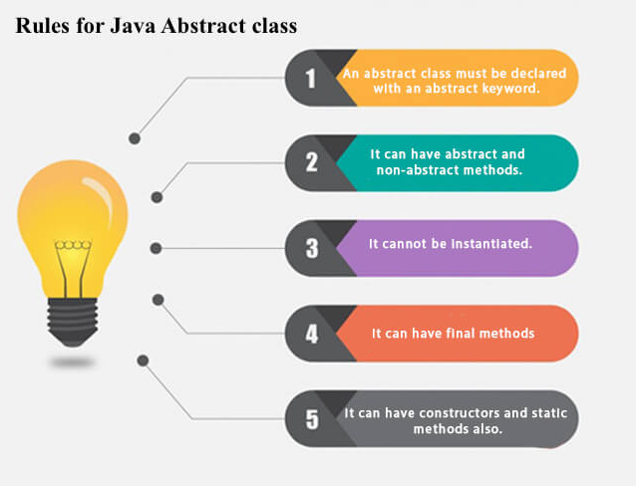
Upcasting is possible
Constructor chaining is also possible

Slide 6
Abstract method
If you want a class to contain a particular method but you want the actual implementation of that method to be determined by child classes, you can declare the method in the parent class as an abstract.
Abstract keyword is used to declare the method as abstract.
An abstract method contains a method signature, but no method body.
Instead of curly braces, an abstract method will have a semicolon (;) at the end.
Syntax: abstract void Draw();

Slide 7
Consequences of declaring abstract method
The class containing it must be declared as abstract.
Any class inheriting the current class must either override the abstract method or declare itself as abstract.
But eventually, a descendant class has to implement the abstract method; otherwise, you would have a hierarchy of abstract classes that cannot be instantiated.

Slide 8
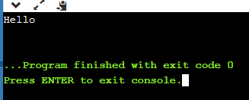
abstract class Main
{
public static void main(String args[])
{
System.out.println(“Hello”);
}
}

Slide 9
abstract class Bike
{
abstract void run();
void draw()
{
System.out.println("Hello from abstract class");
}
}
class Main extends Bike
{
void run()
{
System.out.println("running safely");
}
public static void main(String args[])
{
Bike obj = new Main();
obj.run();
obj.draw();
}
}

Slide 10
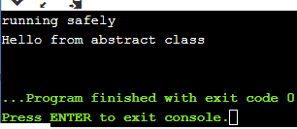
abstract class Bike
{
abstract void run();
void draw()
{
System.out.println("Hello from abstract class");
}
}
class Main extends Bike
{
void run()
{
System.out.println("running safely");
}
public static void main(String args[])
{
Bike obj = new Main();
obj.run();
obj.draw();
}
}

Slide 11
abstract class Shape
{
abstract void draw();
}
class Rectangle extends Shape
{
void draw(){System.out.println("drawing rectangle");}
}
class Circle extends Shape
{
void draw(){System.out.println("drawing circle");}
}
class Main
{
public static void main(String args[])
{
Shape s=new Circle();
s.draw();
}
}

Slide 12
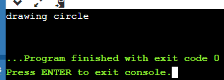
abstract class Shape
{
abstract void draw();
}
class Rectangle extends Shape
{
void draw(){System.out.println("drawing rectangle");}
}
class Circle extends Shape
{
void draw(){System.out.println("drawing circle");}
}
class Main
{
public static void main(String args[])
{
Shape s=new Circle();
s.draw();
}
}

Slide 13
abstract class Shape
{
abstract void draw();
}
class Rectangle extends Shape
{
void draw()
{
System.out.println("drawing rectangle");
}
}
class Main
{
public static void main(String args[])
{
Shape s=new Shape();
s.draw();
}
}

Slide 14
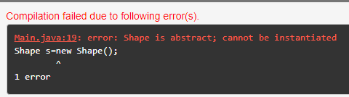
abstract class Shape
{
abstract void draw();
}
class Rectangle extends Shape
{
void draw()
{
System.out.println("drawing rectangle");
}
}
class Main
{
public static void main(String args[])
{
Shape s=new Shape();
s.draw();
}
}

Slide 15
abstract class Bank
{
abstract int getRateOfInterest();
}
class SBI extends Bank
{
int getRateOfInterest()
{
return 7;
}
}
class PNB extends Bank
{
int getRateOfInterest()
{
return 8;
}
}
class Main
{
public static void main(String args[])
{
Bank b;
b=new SBI();
System.out.println("Rate of Interest is: "+b.getRateOfInterest()+" %");
b=new PNB();
System.out.println("Rate of Interest is: "+b.getRateOfInterest()+" %");
}}

Slide 16
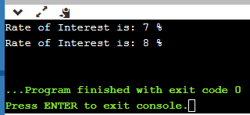
abstract class Bank
{
abstract int getRateOfInterest();
}
class SBI extends Bank
{
int getRateOfInterest()
{
return 7;
}
}
class PNB extends Bank
{
int getRateOfInterest()
{
return 8;
}
}
class Main
{
public static void main(String args[])
{
Bank b;
b=new SBI();
System.out.println("Rate of Interest is: "+b.getRateOfInterest()+" %");
b=new PNB();
System.out.println("Rate of Interest is: "+b.getRateOfInterest()+" %");
}}

Slide 17
abstract class Bike
{
Bike()
{
System.out.println("bike is created");
}
abstract void run();
void changeGear()
{
System.out.println("gear changed");
}
}
class Honda extends Bike
{
void run()
{
System.out.println("running safely..");
}
}
class Main
{
public static void main(String args[])
{
Bike obj = new Honda();
obj.run();
obj.changeGear();
}
}

Slide 18
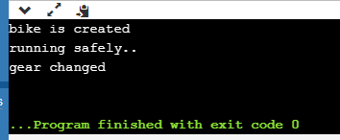
abstract class Bike
{
Bike()
{
System.out.println("bike is created");
}
abstract void run();
void changeGear()
{
System.out.println("gear changed");
}
}
class Honda extends Bike
{
void run()
{
System.out.println("running safely..");
}
}
class Main
{
public static void main(String args[])
{
Bike obj = new Honda();
obj.run();
obj.changeGear();
}
}

Slide 19
class Bike
{
abstract void run();
void draw()
{
System.out.println("Hello from abstract class");
}
}
class Main extends Bike
{
void run()
{
System.out.println("running safely");
}
public static void main(String args[])
{
Bike obj = new Main();
obj.run();
obj.draw();
}
}

Slide 20
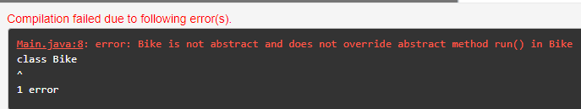
class Bike
{
abstract void run();
void draw()
{
System.out.println("Hello from abstract class");
}
}
class Main extends Bike
{
void run()
{
System.out.println("running safely");
}
public static void main(String args[])
{
Bike obj = new Main();
obj.run();
obj.draw();
}
}

Slide 21
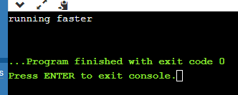
Virtual function in java
The methods that cannot be used for the polymorphism is not considered as a virtual function.
Java does not have a virtual keyword
Every non-static method in Java is a virtual function except for final and private methods.
class Vehicle
{
void run()
{ System.out.println(“running safely"); }
}
public class Trucks extends Vehicle
{
void run()
{ System.out.println(“running faster"); }
public static void main(String args[])
{
Vehicle ob1 = new Trucks();
ob1.make();
}
}

Slide 22
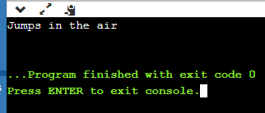
Pure virtual function in java
Pure virtual function is a virtual function for which we don’t have implementations.
An abstract method in Java can be considered as a pure virtual function.
abstract class Dog
{
abstract void jump();
}
class MyDog extends Dog
{
void jump()
{ System.out.println("Jumps in the air"); }
}
public class Runner
{
public static void main(String args[])
{
Dog ob1 = new MyDog();
ob1.jump();
}
}

Slide 23
Thank you!!!

